Slide 1
Osteopathic Considerations
Rebecca J. Bowers, DO
Assistant Professor VCOM-Carolinas
OMM Department
rbowers@carolinas.vcom.edu
(864) 327-9903

Slide 2
Indication for Osteopathic Manipulative Treatment (OMT)
Only one= Somatic Dysfunction
Somatic dysfunction: “Impaired or altered function of related components of the somatic (body framework) system: skeletal, arthrodial, and myofascial structures, and their related vascular, lymphatic, and neural elements.”
Somatic Dysfunction can manifest itself in different ways. Usually described in terms of TART.
Notes:
Definition from the Glossary of Osteopathic Terminology in Foundations of Osteopathic Medicine
TART= Tenderness, asymmetry, restricted motion, tissue texture changes

Slide 3
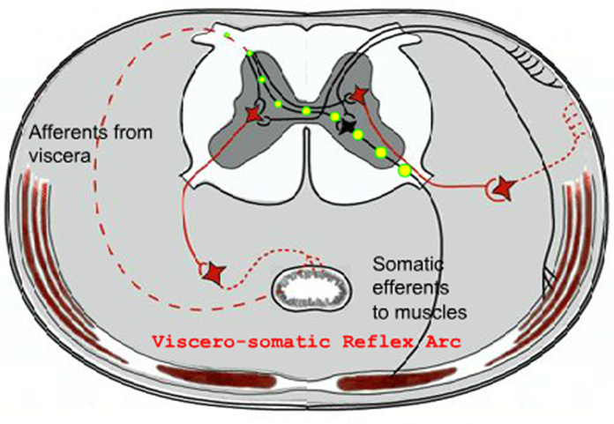
Viscerosomatic Reflex
Localized visceral stimuli producing patterns of reflex response in segmentally related somatic structures
Notes:
Afferent activity from viscera may be passed to segmentally related somatic efferents through viscero-somatic reflex arcs located in the spinal cord
Ex. Muscles that receive their innervation from nerves that originate from the same spinal cord level as the heart’s sympathetics (T1-T6) could have increased tone with cardiac pathology (ex. serratus posterior superior is innervated by the intercostal nerves that originate from T2-T5)

Slide 4
Viscerosomatics
Any reflexive change in the “soma” (aka musculoskeletal system) due to visceral disease.
Chapman points are one type of viscerosomatics
Another common type is TART changes in the paravertebral/paraspinal muscles/tissues at the level that the autonomic nerves for a given organ enter/exit the spinal cord.
Notes:
TART= Tenderness, asymmetry, restricted motion, tissue texture changes

Slide 5
Important Concepts
When a person has visceral disease, there are reflex tissue texture changes that occur at the corresponding somatic spinal levels.
Acutely, the tissues in the corresponding paravertebral area tend to have an influx of blood and feel boggy (aka slightly edematous), warm and with moist overlying skin.
Chronically, the tissues in the corresponding paravertebral area tend to have a dry, cool, ropey (aka sinewy) feel due to the prolonged sympathetic activity in the area.
This is useful for diagnosis (which is neither 100% sensitive or specific, but like any other physical exam finding, can be useful when appreciated in context).
It is also important to look at these areas during recovery from a visceral disease process due to the possibility that a pathologic somatovisceral reflex arc which was brought about by the viscerosomatic reflex of the organ dysfunction may still be active- in these cases, it is important to treat the area of the spine to break the pathologic reflex arc.
The Chapman’s points are most likely anatomically related to organs due to neuro-embryological reasons (but no one has as yet figured out why/how)- they are tender points located posteriorly and anteriorly. These are also useful diagnostically & therapeutically for the same reasons as described above.

Slide 6
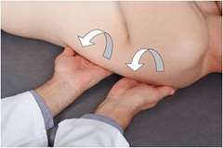
Paravertebral Spinal Facilitation
Levels of Facilitation
HEENT
T1-4; CNs III, VII, IX
Heart
T1-5; CN X
Lungs
T2-7; CN X
Esophagus
T2-6; CN X
Foregut
T5-9; CN X
Midgut
T10-12; CN X
Hindgut
T12-L2; S2-S4
Adrenals
T8-10
Kidneys
T10-L1 ; CN X
Bladder
T10-L2; S2-S4
Gonads
T9-10; CN X
Uterus & cervix
T10-L2; S2-S4
Prostate
T11-L2
Upper Extremity
T2-T7
Lower Extremity
T10-L3
Gently drag fingers along the paravertebral area at the pertinent spinal levels looking for TART
Acute facilitation:
boggy, warm, moist
Chronic facilitation:
condensed, cool, dry
Treat with MFR or rib raising
Notes:
Fore-mid= Lig Treitz & Mid-hind= splenic flecture
These levels are based on FOM 3 & “An Osteopathic Approach to Dx & Tx” which say slightly different things, but the above is a combination of the 2’s overlap.
We seldom ever use just one test to diagnose a condition. There are not many signs or symptoms that are 100% sensitive & specific. All elements of history & physical exam need to be considered when developing a DDX & plan for a patient.
Rib raising: fingers at rib angles (though some DOs place finger pads more medially, closer to the rib heads) & pull laterally, then pump forward- adjust frequency to tissue response- recoil. To encourage decrease of sympathetic tone, frequency should be low. To encourage increase of sympathetic tone (ex. With asthmatic attack), frequency should be high. Low frequency, low velocity rib raising most likely stimulates CT fibers (amongst other various mechanisms- some known & some as of yet discovered). CT fibers are a relatively new discovery. They are only present on areas of skin that have hair (hence not the palms of our hands or the soles of our feet). They signal to a different part of the brain than the other known touch receptors & primarily produce a “pleasant” emotional response. CT fiber information appears to be processed in the insular cortex & only indirectly or not at all processed in the somatosensory cortex.
MFR: I tx 1 hand posterior at level of facilitation & other placed anteriorly over coresponding viscera

Slide 7
Head
Viscerosomatics
Paravertebral Tissue/Texture changes:
T1-T4
Chapman points:
Anteriorly- Bilaterally at 1st intercostal space (multiple) & 1 point on superior aspect of clavicle
Posteriorly- Bilaterally at lower occipital region & upper 4 cervicals
Lymphatic Drainage:
Bilaterally through neck to R lymphatic duct & the thoracic duct (on the L)

Slide 8
Thyroid
Viscerosomatics
Paravertebral Tissue/Texture changes:
T1-T4
Parasympathetics: Via Vagus nerve (CN X) can cause TART from OA-C2
Chapman points:
Anteriorly
2nd intercostal space bilaterally, just lateral to the sternum
Posteriorly
T2 & T3 lamina bilaterally

Slide 9
Heart
Viscerosomatics
Paravertebral Tissue/Texture changes: T1-T5
Chapman points:
Anteriorly- 2nd intercostal space bilaterally
Posteriorly- Between the spinous process and transverse process of T3 bilaterally
Sympathetic Innervation:
Preganglionic neurons: T1-T6
Synapse: superior, middle and inferior cervical ganglia bilaterally
Post-ganglionic fibers:
Right: go to the right deep cardiac plexus and the SA node
Left: go to the left deep cardiac plexus and the AV node
Parasympathetic Innervation:
Pre-ganglionic neurons: vagal nuclei in the medulla
Synapse: parasympathetic ganglia embedded in the cardiac plexus
Post-ganglionic fibers:
Right: go to the SA node
Left: go to the AV node

Slide 10
GI Viscerosomatic Paravertebral TART Levels
Sympathetic-mediated
Esophagus
T2-T6
Stomach
T5-T9
Liver/Gallbladder
T6-T9
Pancreas
T5-T11
Small Intestines- Midgut portion
T10-T12
Appendix
T11
Colon- Midgut portion
T10-T12
Colon- Hindgut portion
T12-L2
Rectum
L2
Parasympathetic-mediated
Foregut & midgut: Via vagus nerve (CN X) can cause TART from OA-C2
Hindgut: Via pudendal nerves (S2-S4) can cause TART at S2-S4
Notes:
Visceral disease can cause reflex sympathetic-mediated TART changes at levels that correspond with the diseased viscera

Slide 11
Embryologic GI Autonomics
Foregut
SNS: T5-T9
PNS: Vagus (TART at OA-C2)
Midgut
SNS: T10-T12
PNS: Vagus (TART at OA-C2)
Hindgut
SNS: T12-L2
PNS: Pudendal nerves- S2-S4 (TART at sacrum)

Slide 12
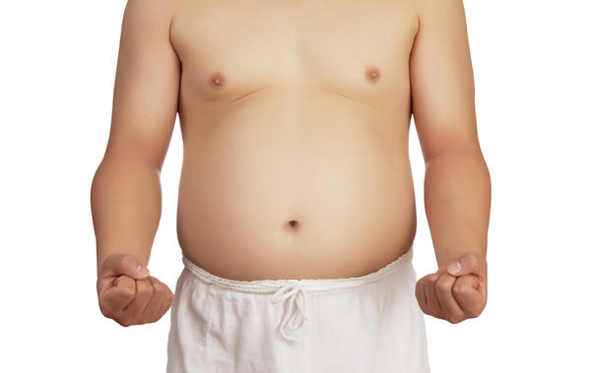
GI Ganglion Chapman’s Points
Foregut portion:
Celiac ganglion (linea alba a couple of centimeters below xiphoid process)
Midgut portion:
Superior Mesenteric Ganglion (linea alba midway between xiphoid & umbilicus)
Hindgut portion:
Inferior mesenteric ganglion (linea alba a couple of centimeters superior to the umbilicus)

Slide 13
Esophagus
Viscerosomatics
Paravertebral Tissue/Texture changes:
T2-T6
Parasympathetics: Via Vagus nerve (CN X) can cause TART from OA-C2
Chapman points:
Anteriorly
2nd intercostal space bilaterally, just lateral to the sternum
Posteriorly
T2 & T3 lamina bilaterally

Slide 14
Stomach
Viscerosomatics
Paravertebral Tissue/Texture changes:
T5-T9
Parasympathetics: Via Vagus nerve (CN X) can cause TART from OA-C2
Chapman points:
Anteriorly
5th & 6th intercostal spaces on the left
Posteriorly-
acid-related problems: T5 lamina on the left
Peristalsis-related problems: T6 lamina on the left
Associated sympathetic ganglion:
Celiac ganglion tender point- look for TART on linea alba a couple of centimeters below xiphoid process

Slide 15
Liver
Viscerosomatics
Paravertebral Tissue/Texture changes:
T6-T9
Parasympathetics: Via Vagus nerve (CN X) can cause TART from OA-C2
Chapman points:
Anteriorly-
5th & 6th intercostal spaces on the right
Posteriorly-
T5 & T6 lamina on the right
Associated sympathetic ganglion:
Celiac ganglion tender point- look for TART on linea alba a couple of centimeters below xiphoid process

Slide 16
Gallbladder
Viscerosomatics
Paravertebral Tissue/Texture changes:
T6-T9
Parasympathetics: Via Vagus nerve (CN X) can cause TART from OA-C2
Chapman points:
Anteriorly-
6th intercostal spaces on the right
Posteriorly-
T6 lamina on the right
Associated sympathetic ganglion:
Celiac ganglion tender point- look for TART on linea alba a couple of centimeters below xiphoid process

Slide 17
Pancreas
Viscerosomatics
Paravertebral Tissue/Texture changes:
T5-T11
Parasympathetics: Via Vagus nerve (CN X) can cause TART from OA-C2
Chapman points:
Anteriorly-
7th intercostal spaces on the right
Posteriorly-
T7 lamina on the right
Associated sympathetic ganglion:
Foregut portion:
Celiac ganglion tender point- look for TART on linea alba a couple of centimeters below xiphoid process
Midgut portion:
Superior Mesenteric Ganglion tender point- look for TART on linea alba midway between xiphoid & umbilicus
Notes:
FOM3 p. 150 & 154

Slide 18
Spleen
Viscerosomatics
Paravertebral Tissue/Texture changes:
T5-T9
Parasympathetics: Via Vagus nerve (CN X) can cause TART from OA-C2
Chapman points:
Anteriorly- 7th intercostal space on the left
Posteriorly- T7 lamina on the left
Associated sympathetic ganglion:
Celiac ganglion tender point- look for TART on linea alba a couple of centimeters below xiphoid process
Notes:
Not technically a GI structure, BUT…
Not derived from the foregut, but gets its sympathetic & vascular supply from same as foregut structures.

Slide 19
Small Intestines
Viscerosomatics
Paravertebral Tissue/Texture changes:
T9-T11
Parasympathetics: Via Vagus nerve (CN X) can cause TART from OA-C2
Chapman points:
Anteriorly-
8th, 9th & 10th intercostal spaces bilaterally
Posteriorly-
T8, T9 & T10 lamina bilaterally
Associated sympathetic ganglia:
Foregut portion:
Celiac ganglion tender point- look for TART on linea alba a couple of centimeters below xiphoid process
Midgut portion:
Superior Mesenteric Ganglion tender point- look for TART on linea alba midway between xiphoid & umbilicus
Notes:
Junction between foregut & hindgut is at the duodenal papilla

Slide 20
Appendix
Viscerosomatics
Paravertebral Tissue/Texture changes:
T11
Parasympathetics: Via Vagus nerve (CN X) can cause TART from OA-C2
Chapman points:
Anteriorly-
Tip of 12th rib on the right
Posteriorly-
T11 lamina on the right
Associated sympathetic ganglion:
Midgut portion:
Superior Mesenteric Ganglion tender point- look for TART on linea alba midway between xiphoid & umbilicus

Slide 21
Colon
Viscerosomatics
Paravertebral Tissue/Texture changes:
T10-L2
Parasympathetics:
Midgut portion- Via Vagus nerve (CN X) can cause TART from OA-C2
Hindgut portion- Via Pudendal nerves (S2-S4) can cause TART at S2-S4
Chapman points:
Anteriorly-
A line just anterior to Iliotibial band (ITB) bilaterally
Right proximal femur= cecum
Knees= transverse colon
Left proximal femur= distal descending colon
Posteriorly-
Bilaterally, triangle patch from the tips of L2-L4 transverse processes out laterally to Iliac crest
Associated sympathetic ganglion:
Midgut portion:
Superior Mesenteric Ganglion tender point- look for TART on linea alba midway between xiphoid & umbilicus
Hindgut portion:
Inferior mesenteric ganglion tender point- look for TART on linea alba a few centimeters superior to the umbilicus
Notes:
Junction between midgut & hindgut is about mid transverse colon

Slide 22
Rectum
Viscerosomatics
Paravertebral Tissue/Texture changes:
L2
Parasympathetics: Via S2-S4 can cause TART at S2-S4
Chapman points:
Anteriorly-
Inferior lesser trochanter bilaterally
Posteriorly-
Lateral sacral crest at the level of S2/S3 bilaterally
Associated sympathetic ganglion:
Hindgut portion:
Inferior mesenteric ganglion tender point- look for TART on linea alba a few centimeters superior to the umbilicus

Slide 23
Upper GI Viscerosomatic Paravertebral TART Levels
Sympathetic-mediated
Esophagus
T2-T6
Stomach
T5-T9
Liver/Gallbladder
T6-T9
Pancreas
T5-T11
Spleen
T5-T9
Parasympathetics via Vagus nerve can cause TART at OA-C2
Notes:
Visceral disease can cause reflex sympathetic-mediated TART changes at levels that correspond with the diseased viscera

Slide 24
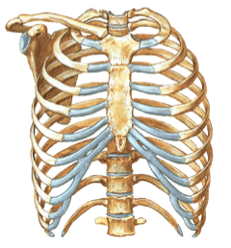
Upper Gastrointestinal Chapman’s Points
Anterior Points
Esophagus (2nd IC)
Stomach
Acid (5th IC Left)
Peristalsis (6th IC Left)
Liver (5th & 6th IC Right)
Pyloric sphincter (midline sternum)
Gallbladder (6th IC Right)
Pancreas (7th IC Right)
Spleen (7th IC Left)
Notes:
IC- Intercostal space
Bilateral unless otherwise stated
Chapman points are one type of viscerosomatic reflexes

Slide 25
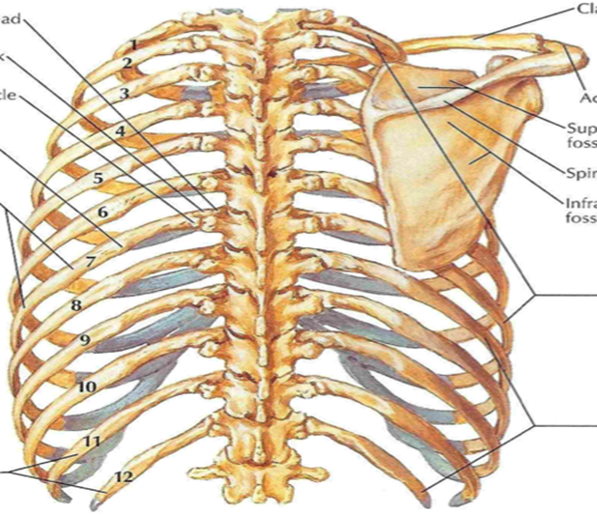
Upper Gastrointestinal Chapman’s Points
Posterior Points
Esophagus (T2 & T3 lamina of TP)
Stomach
Acid (T5 lamina of TP Left)
Peristalsis (T6 lamina of TP Left)
Liver (T5 &T6 lamina of TP Right)
Pyloric sphincter (T9 lamina of TP Right)
Gallbladder (T6 lamina of TP Right)
Pancreas (T7 lamina of TP Right)
Spleen (T7 lamina of TP Left)
Notes:
TP= Transverse Process
Bilateral unless otherwise stated
Chapman points are one type of viscerosomatic reflexes

Slide 26
Lower GI Viscerosomatic Paravertebral TART Levels
Sympathetic-mediated
Small intestines
T9-T11
Appendix
T11
Colon
T11-L2
Rectum
L2
Parasympathetics
Midgut portion: via Vagus (TART at OA-C2)
Hindgut portion: Pudendal nerves- S2-S4 (TART at sacrum)
Notes:
Visceral disease can cause reflex sympathetic-mediated TART changes at levels that correspond with the diseased viscera

Slide 27
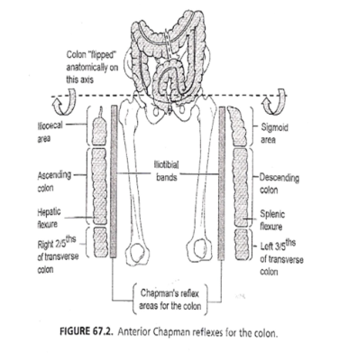
Lower Gastrointestinal Chapman’s Points
Anterior Points
Small Intestine (8th, 9th & 10th IC)
Large Intestine (Anterior aspect of Iliotibial band)
Appendix (Anterior tip of 12th Rib Right)
Rectum (Below Lesser Trochanter)

Slide 28
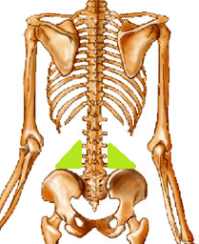
Gastrointestinal Chapman’s Points
Posterior Points
Small Intestine (T8, T9 & T10 lamina of TP) Appendix (T11 lamina of TP Right)
Rectum (Lateral aspect of posterior mid-sacrum)
Colon (triangle area from L3-L5 transverse processes to iliac crest)

Slide 29
Genitourinary

Slide 30
Genitourinary Viscerosomatic Paravertebral TART Levels
Sympathetic-mediated
Kidney
T10-L1
Ureters
TT10-L2
Bladder
T10-L2
Uterus
T10-L2
Prostate
T11-L2
Urethra
T11-L2
Gonads
T9-T10
Parasympathetics
via Vagus nerve can cause TART at OA-C2 or Via S2-S4 can cause TART at S2-S4 (see the individual organ slides for more information)
Notes:
Ureters does not have its own slide due to no Chapman points listed for them. Sympathetics as above. Parasympathetics are likely a combo with the more superior parts having Vagus & the more inferior parts having S2-S4 (pudendal).
Visceral disease can cause reflex sympathetic-mediated TART changes at levels that correspond with the diseased viscera.

Slide 31
Kidney
Viscerosomatics
Paravertebral Tissue/Texture changes:
T10-L1
Parasympathetics: Via Vagus nerve (CN X) can cause TART from OA-C2
Chapman points:
Anteriorly-
1 inch lateral & 1 inch superior of umbilicus
Posteriorly-
T12 & L1 lamina of TP

Slide 32
Adrenals
Viscerosomatics
Paravertebral Tissue/Texture changes:
T8-T10
Parasympathetics: While the adrenals are generally considered modified sympathetic ganglia, there is evidence that they also receive innervation from the Vagus nerve (CN X), which can cause TART from OA-C2
Chapman points:
Anteriorly-
1 inch lateral & 2 inches superior of umbilicus
Posteriorly-
T11 & T12 lamina of TP

Slide 33
Bladder
Viscerosomatics
Paravertebral Tissue/Texture changes:
T10-L2
Parasympathetics: Via S2-S4 can cause TART at S2-S4
Chapman points:
Anteriorly-
Peri-umbilical
Posteriorly-
L2 upper edge of TP

Slide 34
Uterus
Viscerosomatics
Paravertebral Tissue/Texture changes:
T10-L2
Parasympathetics: Via S2-S4 can cause TART at S2-S4
Chapman points:
Anteriorly-
Medial border of obturator foramen
Posteriorly-
L5 Upper edge of TP & lateral sacral base

Slide 35
Prostate
Viscerosomatics
Paravertebral Tissue/Texture changes:
T11-L2
Parasympathetics: Via S2-S4 can cause TART at S2-S4
Chapman points:
Anteriorly-
Outer femur along posterior ITB
Posteriorly-
Lateral sacral base

Slide 36
Urethra
Viscerosomatics
Paravertebral Tissue/Texture changes:
T11-L2
Parasympathetics: Via S2-S4 can cause TART at S2-S4
Chapman points:
Anteriorly-
Superior pubic ramus, 2cm lateral to the symphysis
Posteriorly-
L3 TP

Slide 37
Gonads
Viscerosomatics
Paravertebral Tissue/Texture changes:
T9-T10
Parasympathetics: Via S2-S4 can cause TART at S2-S4 (some vagal fibers involved as well may cause TART from OA-C2)
Chapman points:
Anteriorly-
Ipsilateral superior pubic ramus, 2cm lateral to the symphysis
Posteriorly-
T10 lamina of TP

Slide 38
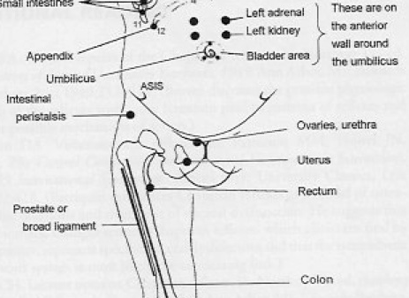
Urinary Chapman’s Points
Anterior Points
Kidney (1 inch lateral & 1 inch superior of umbilicus)
Bladder (peri-umbilical)
Urethra (superior pubic ramus, 2cm lateral to the symphysis)
Anterior
Notes:
Bilateral unless otherwise noted

Slide 39
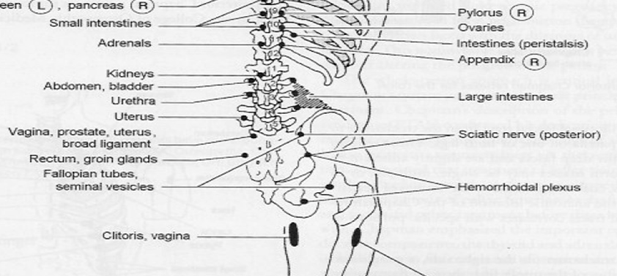
Urinary Chapman’s Points
Posterior Points
Kidney (T12 & L1 lamina of TP)
Bladder (L2 upper edge of TP)
Prostate (Lateral sacral base)
Urethra (L3 TP)
Posterior

Slide 40
Reproductive Chapman’s Points
Anterior
Anterior Points
Ovaries/Testes (ipsilateral superior pubic ramus, 2cm lateral to the symphysis)
Uterus (medial border of obturator foramen)
Prostate/Broad ligament (Outer femur along posterior ITB)

Slide 41
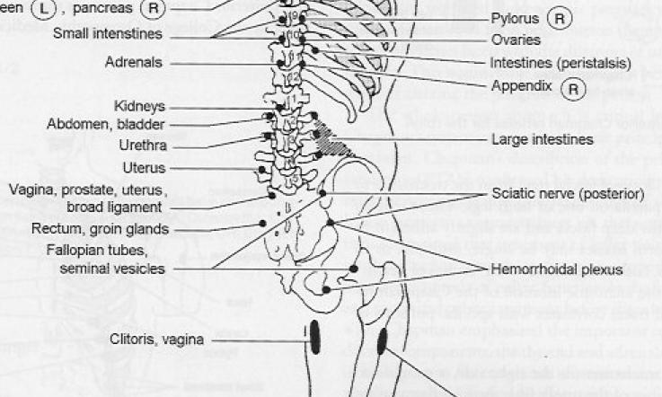
Reproductive Chapman’s Points
Posterior
Posterior Points
Ovaries/Testes (T10 lamina of TP)
Uterus (L5 Upper edge of TP & lateral sacral base)
Prostate/Broad ligament (Lateral sacral base)
* Note location of Fallopian Tubes/Seminal Vesicles [NO anterior points listed for these]
Notes:
P 855-856 Foundations

Slide 42
Infection
Lymphatics
Central: Look for restriction at the thoracic inlet
Peripheral: Look for restriction proximal to the infection (Head: OA/neck; UE: axilla/shoulder; LE: inguinal/pelvic & popliteal fossa/knee)
Respiratory pump: Look for asymmetric movement of ribs and diaphragmatic dysfunction
After restrictions removed, may then consider lymphatic pump techniques (ex. thoracic pump & pedal pump)

Slide 43
Autoimmune
Do not do OMT on joints with evidence of an active flare
Rheumatoid arthritis: cervical HVLA is contraindicated

Slide 44
Content
This Presentation has been created by Rebecca J. Bowers, D.O. for VCOM to use as an educational tool for the instruction of VCOM medical students, faculty or staff.
Some images or wording may come from the personal research, notes or graphics of Rebecca J. Bowers, D.O., and utilization of these in this presentation does not signify that this author has relinquished ownership of them.
Any use of this presentation for purposes other than the aforementioned should be discussed with this author ahead of time.
Thank you.
Notes:
This means other VCOM faculty can use any part of this presentation in part or whole for the purpose of educating VCOM students, staff or faculty.

