Slide 1
Match Day Prep!
Jeff Cashman
&
Lindsey Ridgeway

Slide 2
Objectives
Know the activities and steps of the two match days
Be able to differentiate the process of the AOA Scramble and the NRMP Supplemental Offer and Acceptance Program (SOAP)
Understand the role of the Chair in the Match and how to prepare for the unmatched students
Be prepared for the emotional support needed for the ‘unmatched’ student

Slide 3
A comment about the match process
It is ‘applicant friendly’
Short video that can be very helpful:
How the NRMP matching algorithm works

Slide 4
Defining ERAS and how the process starts
ERAS: Electronic Residency Application Service
Personal statement and Letters of Recommendation
Dean’s letter (includes grades, scatter plot, clinical assessment, comments from biomed, clinical, student services and Dean)
AOA: American Osteopathic Association
Osteopathic programs that rank through NMS
February match date
NMS: National Matching Services
The ‘Osteopathic’ match
Scramble for the students who do not match
Scramble: AOA post-match week program to fill positions that were not filled during the match

Slide 5
Defining some terms
ACGME: Accreditation Council for Graduate Medical Education
Osteopathic and “Allopathic” programs rank through NRMP
March match date
NRMP: National Residency Matching Program
Will be the only matching program starting in 2020
Has the SOAP (Supplemental Offer and Acceptance Program) for the students who do not match
SOAP: Supplemental Offer and Acceptance Program
How students rank into residency after the initial match

Slide 6
Defining Residency Programs by ERAS
Categorical Programs: A program that is 3-5 years in length and begins with year 1
Listed as ‘C’ in ERAS
May be listed as “M” for some medicine and pediatric programs
Preliminary/Transitional year: The first year of residency. Often at a site different than the following years of residency
Listed as “P” in NRMP
Advanced position: programs that start in residency year 2
Listed as “A” in NRMP

Slide 7
AOA Match

Slide 8
AOA Match Day
February 4, 2019!!!
Final time there will be an AOA match
January 8th, the rank order list opened
January 18th is the final date for students to submit a ‘rank order list’
February 4th: Results of the Match are released to all participants in the Match
In this match, students will know where he or she has matched on Feb. 4th (this is different than ACGME)
Beginning at noon, students who did not match may contact programs with open positions…the SCRAMBLE! (we may have this earlier)
AOA will release a list of available positions
We will try to keep in touch with programs to see if there are still open positions (some may move positions to the ACGME match instead of picking up residents in the scramble)

Slide 9
AOA Scramble
The AOA will post the list of the open positions
As soon as we have the list (or when it is posted), we will make copies and distribute to chairs who are available and on campus
Has been different times in the past
Students and programs negotiate directly with each other
Students should contact and try to obtain and interview with programs who have open positions
When a student reaches a contractual agreement (and has the contract in hand), the student must sign first and then the student will be ‘matched’
A student may receive offers from multiple programs, so it is not completed until the contract is signed
Chairs, advisors, school representatives may contact programs on a student’s behalf after noon
Some schools do not do this, so it is a benefit to our unmatched students!

Slide 10
AOA Scramble, continued…
Faculty will be assigned students who did not match
Will try to have this be the chair, who should already have a relationship
Last year, many programs moved ‘unfilled’ positions into the ACGME match
If they have obtained accreditation
If you find that a program is holding positions for the ACGME match (which will happen), please make this known to Dr. Cashman or Dr. Ridgeway
This will help to keep track in case other students are working on the same spot

Slide 11
Tips on the Scramble
FIRST! Check on the student’s well-being
This is a stressful time, things did not go well and the student just found out within the last hour or two
Determine how competitive the student is for your field or seek another field
The majority of unmatched programs will fall into 4 categories: (Internal Medicine, Family Medicine, Transitional Year, Preliminary Surgery)
***Cashman/Ridgeway Opinion: Encourage the student to find a full residency, not a transitional year or preliminary year
This may be a challenge, and has to be an individualized decision, but it will be more difficult for many of these unmatched students in next year’s match which is only ACGME
Make calls for students
Determine if new letters of recommendation are needed (for a different field)
May need an updated personal statement
Often new LORs will be submitted through ERAS

Slide 12
Emotional support for the student
Involve Student Services
Check on the student!
Acknowledge that this is a major shift and will affect, possibly, many in his or her family
Empathize: The student has been under stress building up to the match, has likely made plans believing he or she will obtain a position
This WILL create some change
Location, field of practice, etc.
Make sure the student knows we are here to help
Although stressful, timing is extremely important (spots will fill!)
Be supportive, but will have to change the focus to obtaining a position quickly

Slide 13
Other support for the student
Students will mostly communicate with programs through email and phone
Need to have phone access (keep a charger handy!)
Need to have internet access for email (and a printer when a contract is offered)
Important if students are on away rotations (or international rotations)
Students do not NEED to be on campus, but can be helpful to discuss in person
Will encourage students to come to campus if unmatched
We will plan to meet in the conference rooms on the 3rd floor
We will plan to have small group rooms reserved for individual discussions

Slide 14
ACGME Match

Slide 15
ACGME Match Day
Majority of students will participate in the ACGME match
March 11th is when students will be notified if he or she matches
If a student does not match, he or she may participate in SOAP
Or, the student can wait until after March 15th to contact AOA programs
Students will be notified at 11AM, Monday, March 11th if he or she matched
Not notified of where he or she matched
Friday, March 15th is Match Day
1PM the match results (location) are known to applicants
Match Day Celebration! (FR8 Yard at 4PM for match day celebration)!!

Slide 16
SOAP process
Supplemental Offer and Acceptance Program
Students must be registered in ACGME match in order to participate in SOAP
SOAP opens on Monday, March 11th, 11AM (access list of unfilled positions)
At 12PM applicants can prepare applications
Monday, March 11th, at 3PM, applications for SOAP can be reviewed
New LORs or Personal Statements need to be uploaded
Can only submit 45 applications in SOAP
*Cashman/Ridgeway Opinion: Consider keeping 5-10 programs for round 2/3
***Applicants and representatives (faculty, etc.) may not communicate with a program until contacted***

Slide 17
SOAP process continued…
Tuesday March 12th is a day the student will need to make available for phone interviews and communications with programs
The student may need to be off rotations that day
Wednesday, March 13th, at noon: SOAP Round 1
Similar to another match process
Offers must be accepted by 2PM (ACCEPT!!!!)
Most positions are filled after Round 1
SOAP Round 2 opens at noon on Wednesday (3/13)
Must modify and recertify program preference list by 2:55PM
3PM on Wednesday applicants receive round 2 offers
Must accept/reject by 5PM (ACCEPT!!!)

Slide 18
SOAP process continued…
SOAP Round 3 opens at 5:05PM on Wednesday (3/14)
Must modify and recertify program preference list by 8:55 AM on Thursday
9AM on Thursday applicants receive round 3 offers
Must accept/reject by 11AM (ACCEPT!!!)
SOAP ends at noon on March 14th
List of open positions, including programs who did not participate in Match (including AOA programs) is updated
Students may not contact AOA programs during the SOAP (March 11th-15th)
However, after March 15th, students, attendings, faculty, whomever, can contact any program with open positions (AOA or ACGME)

Slide 19
Comparing the two matches
AOA Match Day
ACGME Match Day
Results known on match day (Feb 4th)
Scramble starts at noon on 2/4
School representatives can contact programs
Contracts can be offered at any point
Match status is known Monday (3/11), location not known until Friday (3/15)
SOAP process starts at noon on 3/11, but round 1 of SOAP match is Wednesday 3/13
No contact can be made with programs (unless contacted by the program)
3 supplemental matches during the week

Slide 20
Role of Faculty
Consider having at ‘Template’ LOR form so you can just add a name and a few details from the CV to have a LOR written
Be an emotional support for the student
Consider and have a difficult conversation if the student is not a strong candidate for a particular field
Discuss positives and negatives for one year programs
Will allow student to receive a license, but will have to ‘re-match’ in order to be in a residency
Next year will only have one match, may be a more competitive year
Can allow students desiring ‘non-available’ fields a second shot at matching in that desired field

Slide 21
More information for unmatched students
Students will need access to a computer with internet access and access to a phone, so he or she does not need to be on campus, but can be beneficial
A student must be registered for the match (NMS or NRMP) in order to participate in the ‘post-match’ Scramble/SOAP
May have ‘partially’ matched students
Mostly this will be students who obtained an ‘advanced’ position (programs starting with year 2) who need a ‘intern year’
Can only apply to what you need (cannot find a new program-preliminary or advanced)
If unmatched, may apply to any program
Must submit SOAP application through ERAS

Slide 22
March Match-ness!!!

Slide 23
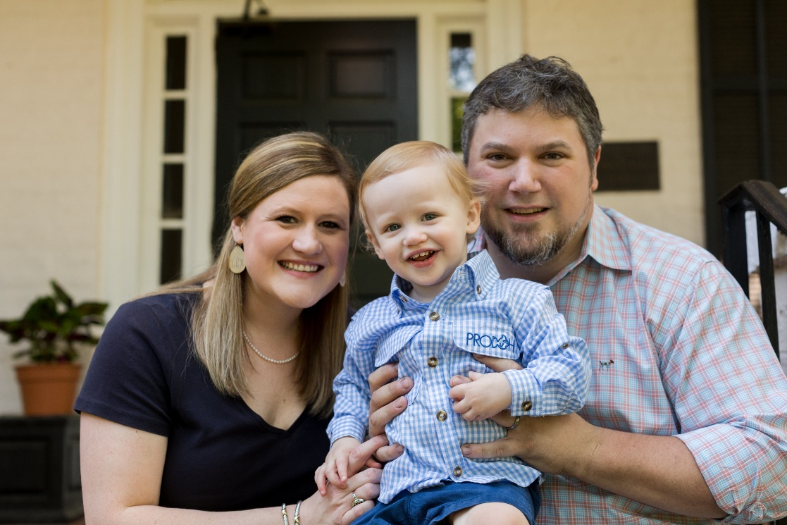
Questions????
Cashman Cell: (843) 367-8877

