Slide 1
IRBNet: New Users
Presented by
Debbie Geiger, CIP®, IRB Administrator
Edward Via College of Osteopathic Medicine, Research Office
dgeiger@vcom.edu or irb@vcom.edu

Slide 2
National Research Network ®
New User Energizer
Training Energizer
IRBNet provides the research community with an unmatched set of secure, web-based collaboration tools to support the design, management, review and oversight of research involving human subjects, animal models, recombinant DNA, and more.
This Energizer covers how to register an account in IRBNet and manage your User Profile. It will illustrate how to:
Create and activate your account in IRBNet
Manage your affiliations from your User Profile
Add and submit necessary Training & Credential
records
Maintain your T&C records on an on-going basis
1
RESEARCH DATAWARE
Innovation in Research Management
© 2001 - 2013Research Dataware. LLC All rights reserved.

Slide 3
New User Registration
New User Energizer
Training Energizer
To begin the registration process, go to www.irbnet.org and click the New User Registration link.
Users that are not registered on IRBNet may click here to self- register.
If you have forgotten your password, click here.

Slide 4
Basic Account Information
New User Energizer
Training Energizer
Fill out your first and last name, and choose a username and password.
Always use your proper name, with standard capitalization as this information is used throughout the system.
Passwords must contain 8 (eight) characters.

Slide 5
Individual Terms of Use
New User Energizer
Training Energizer
All IRBNet users must agree to the Individual Terms of Use in order to register on the system.
Click “Accept” to accept the
terms of use and continue.

Slide 6
Select Your Organization
New User Energizer
Training Energizer
Search to find your local institution. Contact your local coordinator if you are unclear where you should register.
Search to find your local institution. You may search for your institution using any terms, such as “metro”.
Highlight your institution, and click continue.

Slide 7
VCOM Research Department
VCOM Institutional Review Board (IRB)

Slide 8
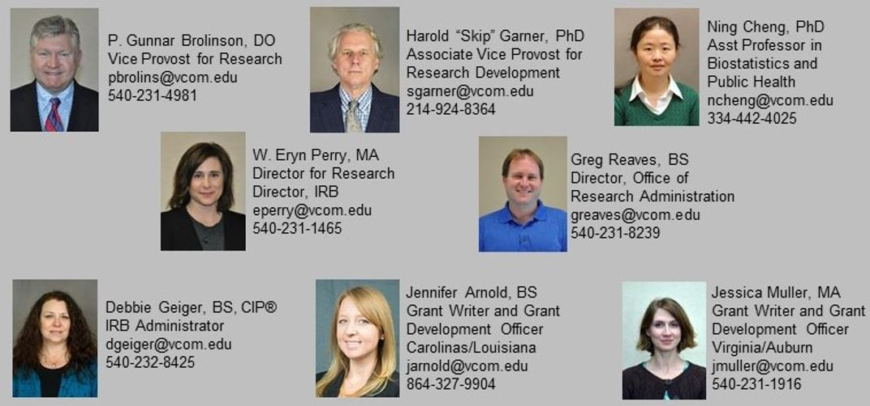
VCOM Research Department
Our Research Team Members are here to help!
https://www.vcom.edu/research

Slide 9
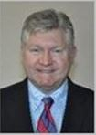
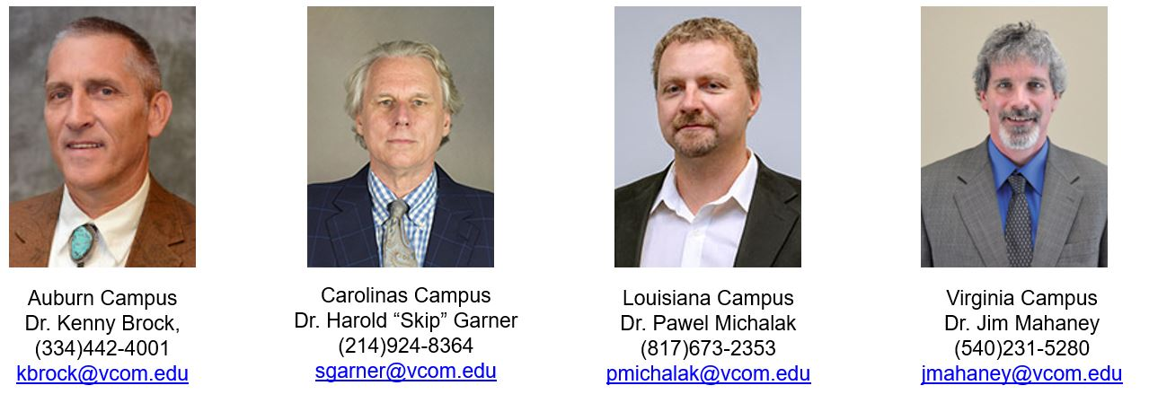
VCOM Institutional Review Board (IRB)
P. Gunnar Brolinson, DO
Vice Provost for Research, IRB Chairman
Campus Co-Chairmen, VCOM IRB

Slide 10
Select Your Organization
New User Energizer
Training Energizer
Search to find your local institution. Contact your local coordinator if you are unclear where you should register.
Search to find your local institution. You may search for your institution using any terms, such as “metro”.
Edward Via
Edward Via College of Osteopathic Medicine, Blacksburg, VA
Highlight your institution, and click continue.

Slide 11
Contact Information
New User Energizer
Training Energizer
Fill in your contact information. Be sure to use a valid email address. You will need to be able to receive emails from IRBNet in order to activate your account.
Use your institution-approved email to ensure that you receive your activation email and all automatic notifications from the system. Failure to use an appropriate email address may result in your account not being activated.

Slide 12
Finalize Registration
New User Energizer
Training Energizer
Verify that the information you have entered is correct. If any of the fields need to be edited, you may do so using the
yellow “Edit” links.
Click “Register” and continue. An automated activation email will be sent to your email address.
Take a moment to confirm that the correct email is listed. It can be corrected by clicking “Edit” and re- entering the address.

Slide 13
Registration Complete
New User Energizer
Training Energizer
Once you finalize your registration, an activation email will be sent to your registered email address. You will need to click the link within that email to activate your account.
Click “Continue” to finalize your registration and send the activation email.

Slide 14
Complete Activation
New User Energizer
Training Energizer
Visit the inbox of your registered email address and click the link within the “IRBNet Activation Required” email to activate your account.
From your email inbox,
open the “IRBNet
Activation Required” message.
Click the link to complete your activation.
Congratulations, you are now a member of the National Research Network!

Slide 15
Manage Affiliations
New User Energizer
Training Energizer
From the User Profile page you can add additional affiliations and trigger additional activation emails, if needed.
Use the Add an Additional Affiliation link to add research affiliations.
This is helpful if you are affiliated with multiple institutions, or if you are both a researcher and a board member.
Click the “Send me an activation email” link to trigger an additional activation email to your registered email address.

Slide 16
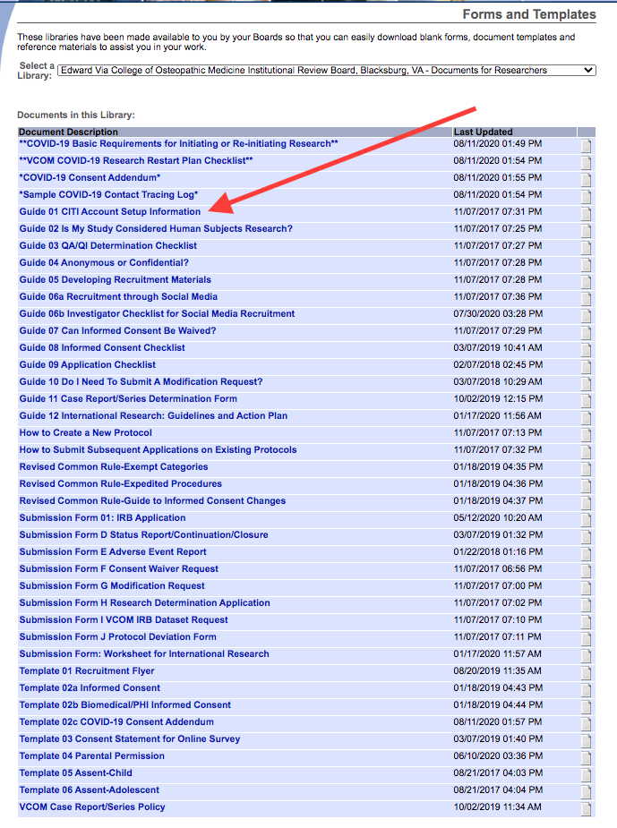
Training and Credentials for VCOM Investigators
Protection of Human Research Subjects course – CITI preferred
CITI= Collaborative Institutional Training Initiative
https://about.citiprogram.org/en/homepage/
https://www.vcom.edu/research/irb

Slide 17
Add Training & Credential Records
New User Energizer
Training Energizer
Upload appropriate Training & Credential (T&C) documents to your User Profile, as required by your local institution.
Click here to upload T&C documents.

Slide 18
Enter Record Information
New User Energizer
Training Energizer
Enter the appropriate information and select the correct T&C document. Be sure to enter accurate Credit Hours and Expiration Date if applicable.
Click Attach to upload the document.
Click Browse to select the correct T&C document to upload.

Slide 19
Submit T&C Documents
New User Energizer
Training Energizer
Submit uploaded T&C documents to the correct committee, according to local committee SOPs.
Click to submit the document to your committee.

Slide 20
Manage your User Profile
New User Energizer
Training Energizer
Upload additional T&C documents as needed and keep your existing documents up to date as credentials change.
To update a document, use the Pencil icon.
The bell icon shows Messages and Alerts.
Message
coordinators using the envelope icon.
Highlighted Expiration Date indicates this document will expire within the next 60 days.
20

Slide 21
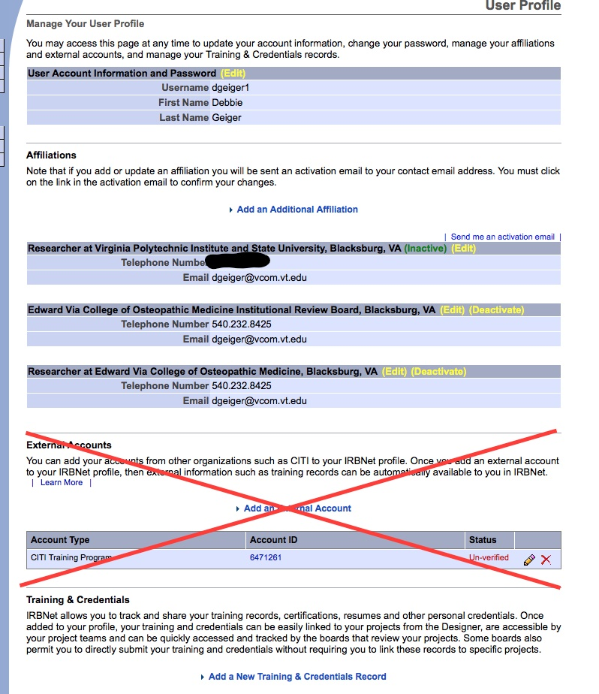

Slide 22
Where to Get Help...
New User Energizer
Training Energizer
Your Committee Office can offer you assistance and training on IRBNet as well as advice on how to comply with important policies and standards as you use IRBNet.
Debbie Geiger, IRB Administrator
dgeiger@vcom.edu
Eryn Perry, Director for Research
eperry@vcom.edu
Coming Soon…
IRBNet Part 2: New Project Submissions
15
RESEARCH DATAWARE
Innovation in Research Management
© 2001 - 2013Research Dataware. LLC All rights reserved.

